Slide 1

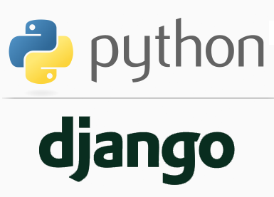
FULL STACK WEB DEVELOPMENT WITH DJANGO
Lecture 1

Slide 2

Today’s Agenda
An Introduction To Django
Pre-requisites
What Is Django ?
Front End V/s Back End
What Is Full Stack Development ?
History Of Django
Course Outline

Slide 3
What You Should Know ?
To start learning Full Stack Development With Django , you must be familiar with following topics in Python:
List , Tuple , String, Dictionary
Functions & OOPs Concepts
Exception Handling
Database Programming
No GUI is required.
No knowledge of tkinter or PyQT is required

Slide 4
What Is Django ?
Django is a free and open source web application development framework written in Python.
To fully understand this definition we must discuss each of the words highlighted in blue color separately, which are:
Free
Open Source
Web Application
Framework

Slide 5
What Is Free And Open Source ?
Free , simply means that just like Python , we don’t have to pay anything for downloading and using Django.
Open Source means we can modify and share Django because it’s source code is publicly available.

Slide 6
What Is A Web Application ?
A web application which most of the non IT people refer to as a website , is a collection of web pages .
In technical terms , a Web application (Web app) is a program that executes on a server on the Internet and it’s output is delivered to the browser

Slide 7
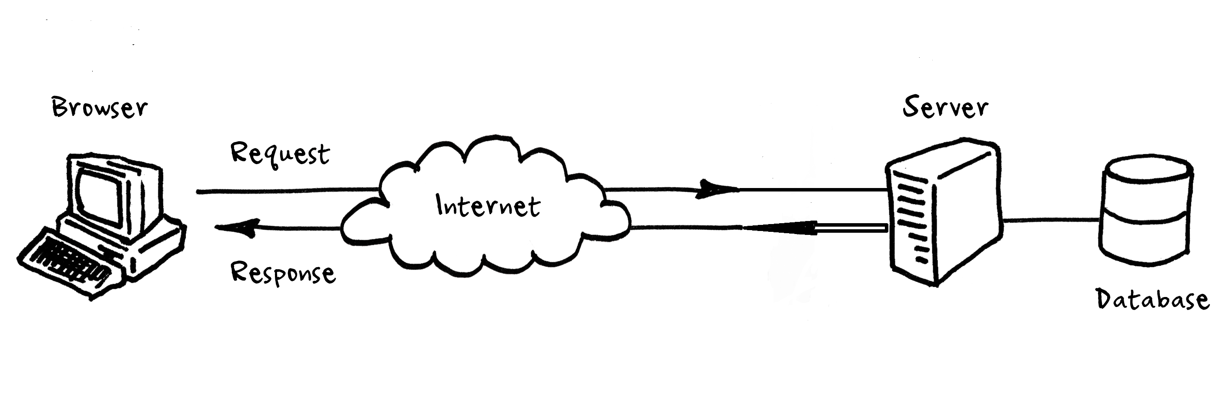
What Is A Web Application ?

Slide 8
Examples Of A Web Application
Almost every application we access on the internet is a web application.
Some most common examples are:
Google
Youtube
Facebook
Netflix
Amazon
Flipkart

Slide 9
Components Of A Web Application
Every web application , primarily contains 2 very important components and these are called :
Front End
AND
Back End

Slide 10
What Is Front End ?
The front end of a web application is the part a user sees and directly interacts with.
Also referred to as client-side, it includes everything the user experiences directly: from text and colors to buttons, images etc

Slide 11
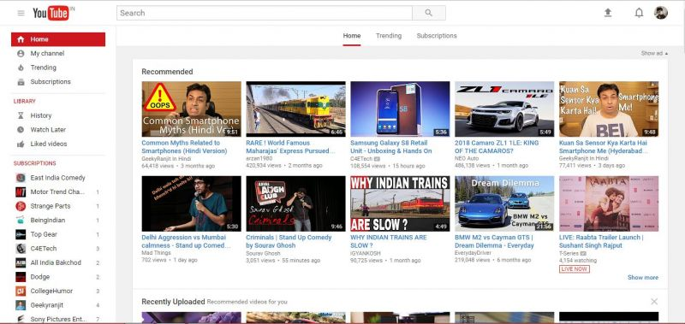
What Is Front End ?

Slide 12
What Is Back End ?
The backend (or “server-side”) is the portion of the website you don’t see.
It is in charge of calculations, business logic, database interactions etc
The backend communicates with the front-end, sending and receiving information to be displayed as a web page.

Slide 13
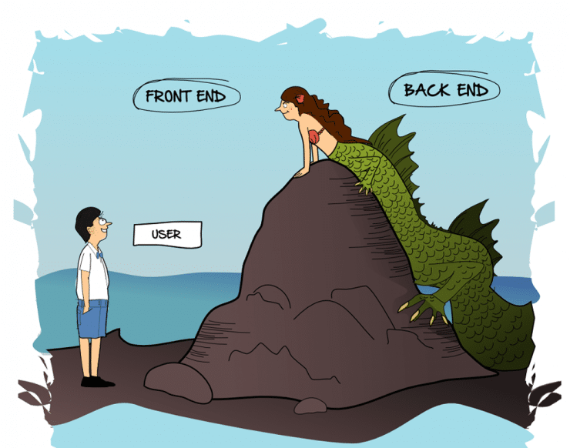
Front End V/s Back End

Slide 14
What Is Front End Made Up Of ?
The front end is built with 6 key technologies :
HTML
CSS
JavaScript
Bootstrap
Ajax
jQuery
The three very important of them are HTML , CSS and JavaScript

Slide 15
The Three Key Players In Front End
HTML (HyperText Markup Language)
CSS (Cascading Style Sheets)
JavaScript
It is the backbone of the Web. Every website you visit is built with HTML.
It takes care of all the structure and content
It is what controls the look and feel of the page.
CSS sets the colors, fonts, background images, and even the way the page
is laid out
It is a programming language commonly used to create interactive effects
within web browsers.

Slide 16
The Three Key Players In Front End
In short we can remember that:
HTML is for content
CSS is for presentation
JavaScript is for behaviour

Slide 17
What Is Back End Made Up Of ?
A backend developer needs to understand 2 very important elements :
A server side programming language like Python , Java, PHP , Ruby, C# etc
AND
Database Management System like Oracle, MySQL etc.

Slide 18
What We Will Learn ?
We will learn both Front End Technologies as well as Back End Technologies as a part of this course.
And this is called FULL STACK WEB DEVELOPMENT.

Slide 19
What Full Stack Web Development Contains ?
Full stack developers work with both the front and back end of a website or web application.
They’re familiar with HTML, CSS, JavaScript and one or more back end language/framework which in our case are Python and Django.

Slide 20
What Is A Web Application Framework ?
Now the last term in Django’s definition is web application framework . So let’s understand it
A web application framework is a set of tools which can be used to develop websites and web applications .
These tools help us develop these applications in a faster and easier way.

Slide 21
What Is Meant By Tools ?
When we're building a webapp, we always need a similar set of components like:
A way to handle user authentication (signing up, signing in, signing out)
An admin panel for our webapp
A way to interact with the user like HTML forms
Allowing users to upload files, etc.
Luckily for all these activities Django gives us ready-made components to use.

Slide 22
What Tools Django Provides?
Following are the tools provided by Django that help our web application building easier and rapid:
User Management : For handling user login/authentication
ORM : For handling database related code
HTML Templating : For generating dynamic HTML
Form Handling : For accepting user inputs
Url Routing : For transferring request to correct web page
And many more. . .

Slide 23
What Django Is Not?
Before moving any further , let’s clarify what Django is not or what it does not means .
Django is not a programming language
Python is the programming language
Django is written in Python , but it itself is not a programming language
Django is not a web server
Web server is a software on which we can host our websites or web apps
Django does comes with a web server for testing our apps on local machine but it itself is not a web server.

Slide 24
History Of Django
Started as an internal project at the Lawrence Journal-World newspaper at Lawrence, Kansas, in the United States in 2003.
In 2005, Django was released it to the public as an open source project

Slide 25
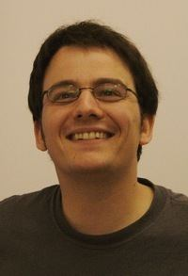
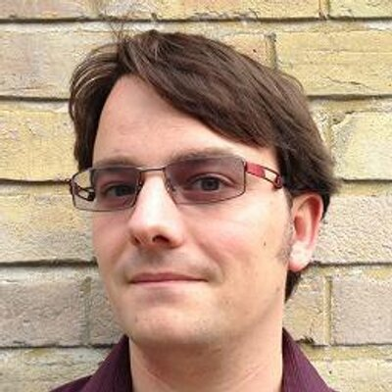
Who Developed Django ?
The credit of developing Django goes to Adrian Holovaty and Simon Willison who developed the initial version of Django at the Lawrence Journal-World newspaper.
Adrian Holovaty
Simon Willison

Slide 26
Django In 2019
As of now, i.e in 2019 – the Django framework operates under the guidance of the Django Software Foundation (DSF).
Now Django has
Over 1000 contributors
More than 15 release versions. Current latest is 2.1.7
Over 3000 packages specifically designed to work with the Django framework
It’s official website is https://www.djangoproject.com/

Slide 27
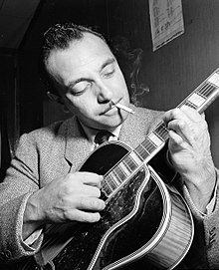
How Django Got It’s Name ?
The name Django is given after a French guitarist Django Reinhardt.
This is because both Willison and Holovaty are big fan of Django Reinhardt

Slide 28
Famous Websites Developed Using Django
There are numerous examples of popular, high-load websites/webapps that have been developed using Django.
Here are some of the most popular of them:
NASA
Instagram
Mozilla
Spotify
Reddit
Dropbox
And above all YouTube

Slide 29
Top Features Of Django
Django has 5 very important features which makes it one of the best framework for web development
These are:
Rapid Development
Fully Loaded
Secure
Scalable
Versatile

Slide 30
Rapid Development
Django was designed with the intention to make a framework which takes less time to build web application.
The project implementation phase is a very lengthy and time taking phase but Django creates it rapidly.

Slide 31
Fully Loaded
Every web application has to do some common tasks like Authentication , Administration, Session Management , Site Maps etc
Django includes various helping task modules and libraries which can be used to handle these tasks allowing the developer to focus on the core part of his app.

Slide 32
Secure
Django takes security very seriously and helps developers to protect themselves from many common security mistakes, like :
SQL injection
CSRF
Clickjacking
CSS

Slide 33
Scalable
Scalablity means the ability of a web application to handle heavy traffic.
Django is one of the best frameworks which gives built in support to scalability to meet the heavy traffic demand.

Slide 34
Versatile
Django is versatile in nature which allows it to build applications for different-different domains.
Now a days, companies are using Django to build various types of applications like: social networks sites or scientific computing platforms etc.

Slide 35
What We Will Learn ?
As mentioned before this is a FULL STACK DEVELOPMENT COURSE, so you will learn both front end and back end technology stack:
Finally all this will be incorporated in a PROJECT
Front End | Back End
HTML | Django Models | Url Routing
CSS | Django Views | Administration
JavaScript | Django Templates
jQuery | ORM
Ajax | User Management
Bootstrap | Form Handling

